Slide 1
Route Preprocessing Algorithm
Xun Liu 11-27-2017

Slide 2
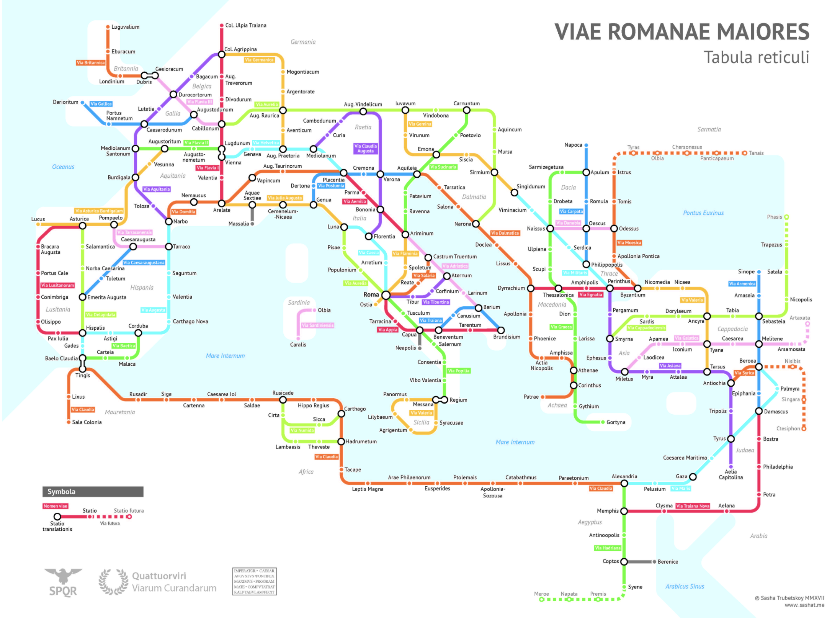
Roman Empire in the year 125AD

Slide 3
Agenda
Problem Set
Basic Algorithm
Goal directed technical
Hierarchical technical
Bounded hop technical
Q&A

Slide 4
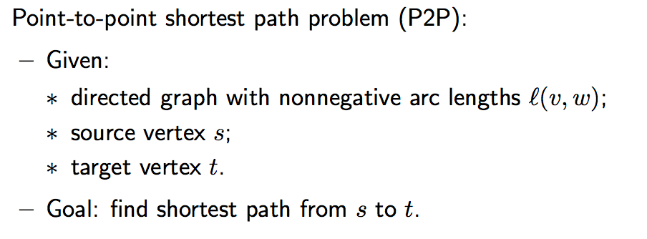
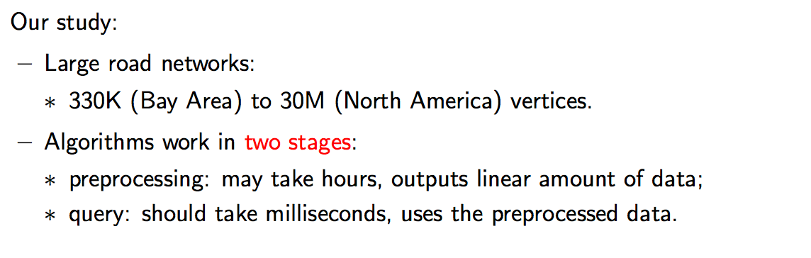
Shortest Paths

Slide 5
Route Planning
Input: Directed weighted graph G
Query(s,t) – find shortest route in G from s to t
No preprocessing | With preprocessing
Fast query time Variations of Dijksta’s algorithm | Query Time ↔ Space trade-off Trivial: Distance table O(1) time & O(n²) space Practice: Try to exploit graph properties

Slide 6
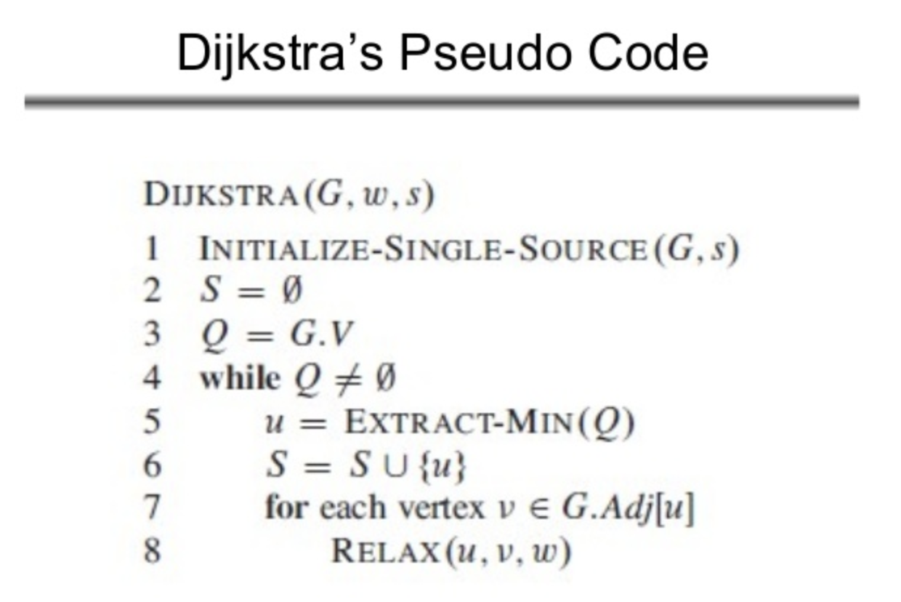
Dijkstra

Slide 7
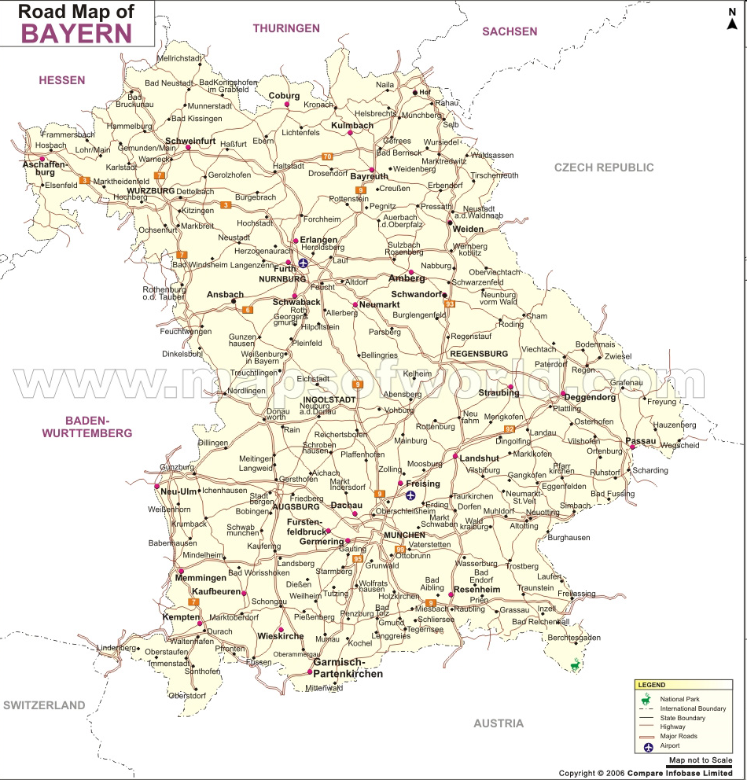
Routing
Unidirectional Dijkstra’s shortest path algorithm

Slide 8
Routing
Bi-directional Dijkstra’s shortest path algorithm
Bidirectional search (from Bayreuth and from Erlangen)

Slide 9
Routing
Bi-directional Dijkstra’s shortest path algorithm
Bidirectional search (from Bayreuth and from Erlangen)

Slide 10
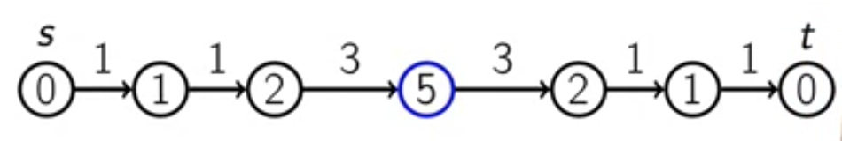
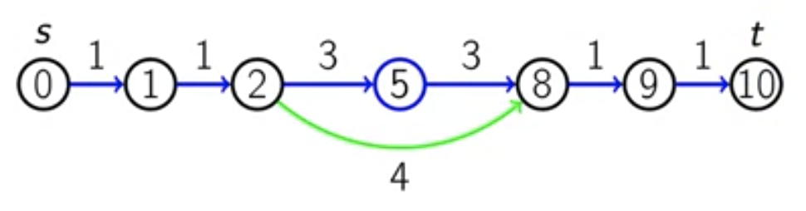
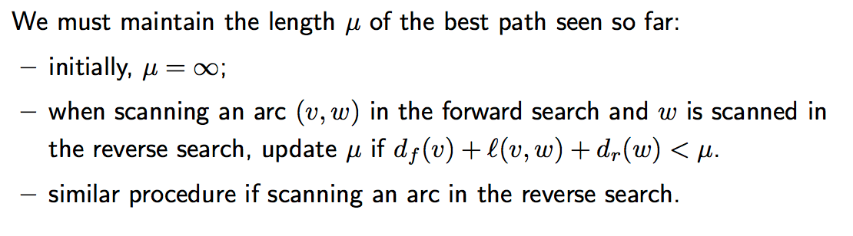

Frist meet, stop()?

Slide 11
Agenda
Problem Set
Basic Algorithm
Goal directed technical
Hierarchical technical
Bounded hop technical
Q&A

Slide 12
A* ≡ Goal directed
Input: Weighted graph G with non-negative edges
Query(s,t): Shortest route queries
Idea Let h(v) be ”heights” & define w’(u,v) = w(u,v) + h(v) - h(u)
Fact w’(s→v₁⋅⋅⋅v_{k}→t) = w(s→v₁⋅⋅⋅v_{k}→t) + h(t) - h(s) ⇒ G and G’ have identical shortest paths
Fact If w’≥0 ⇒ we can use Dijkstra’s algorithm If w’≥0 and h(t)=0 ⇒ h(v) lower bound on distance v→t
Ex. 1 Planar graphs with L₂ distance, let h(v) = |t-v|₂ ⇒ triangle inequality ensures w’ non-negative
Ex. 2 h(v) = d_{G}(v,t) ⇒ w’(s,t) = 0 ⇒ Dijkstra’s algorithm would only explore the shortest path
Note Bidirectional A* ≡ Bidirectional Dijkstra and A* combined
v
h(v)
w(u,v)
t
u
h(u)
Notes:
Intuitive idea: We would like to run ”downhill”, i.e. t should have low height and s high height
Height can also be thought of as a potential
Ex. 2 – not practical example: Knowing d_{G}(v,t) would require computing the shortest paths. But it motivates landmarks.
Bidirectional A* can also use two different height functions, but then definition and termination condition more envolved, and the height functions must be consistent

Slide 13
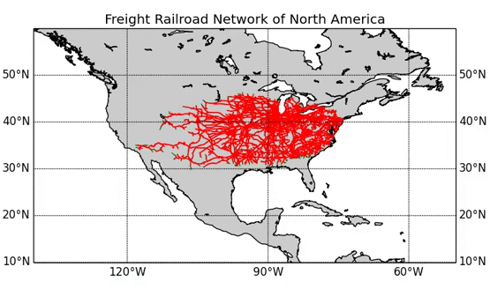
A*
http://en.wikipedia.org/wiki/A*_search_algorithm
Notes:
Washington DC -> Los Angeles, h = spherical distance

Slide 14
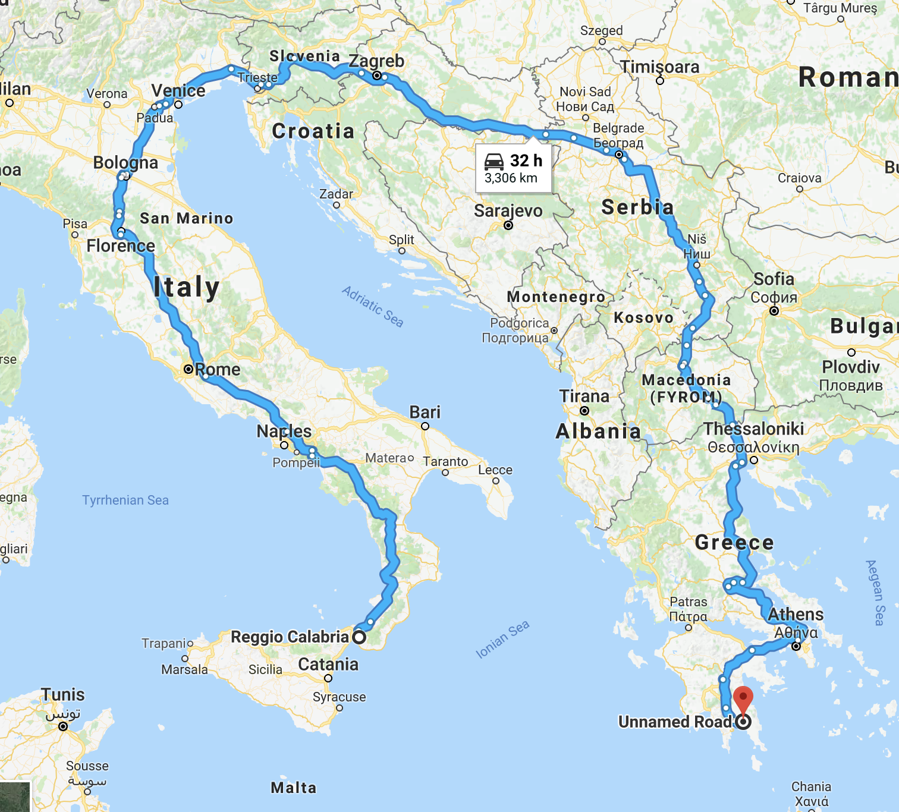
Achilles' Heel
http://en.wikipedia.org/wiki/A*_search_algorithm
Notes:
Washington DC -> Los Angeles, h = spherical distance

Slide 15
Landmarks
Select a small number of vertices L (Landmarks)
Notes:
Space increases with number of landmarks !

Slide 16
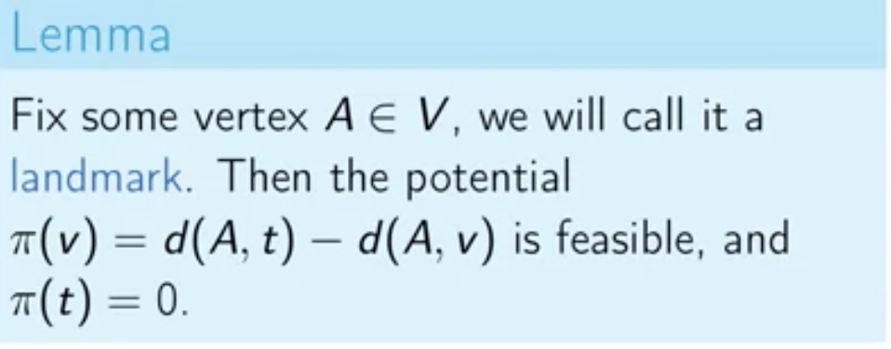
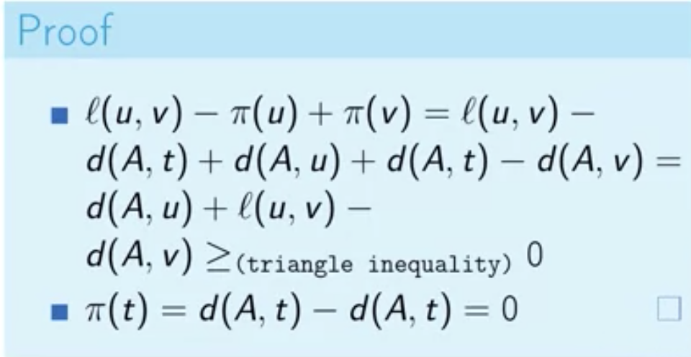
Landmarks

Slide 17
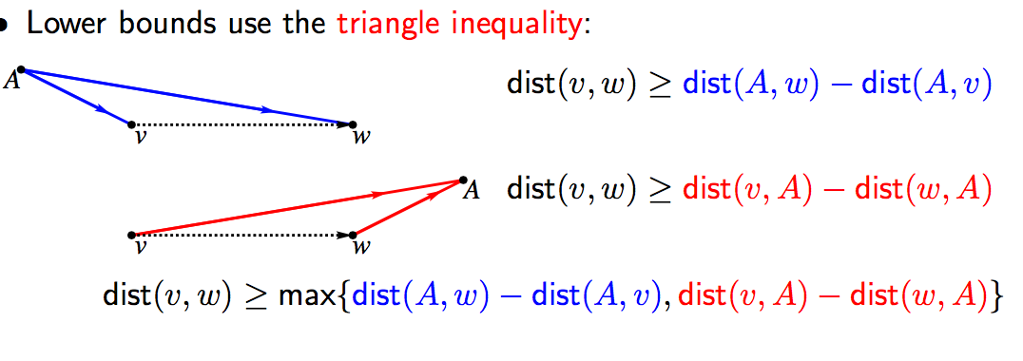
Lower Bounds

Slide 18
Landmarks
Select a small number of vertices L (Landmarks)
For all nodes v store distance vector d(v,l) to all landmarks l∈L
Idea In A* algorithm fix one landmark l∈L, and use h(v) = d(v,l) (valid by triangle inequality)
Practice: Use more than one landmark to find lower bounds on d(v,t) Dynamicly increase landmark set during search Bidirectional A*
t
d(t,l)
v
d(v,t)
s
l
w’=0
d(v,l)
Notes:
Space increases with number of landmarks !

Slide 19
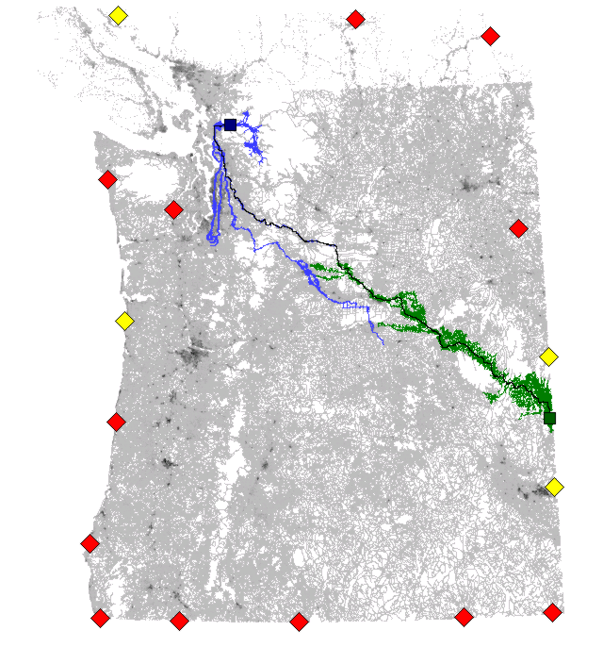
Bidirectional A* with Landmarks
http://www.cs.princeton.edu/courses/archive/spr06/cos423/Handouts/EPP%20shortest%20path%20algorithms.pdf
Notes:
Werneck & Goldberg were at MicroSoft
Yellow & Red = landmarks, Yellow = used landmarks during the bidirectional search

Slide 20
Agenda
Problem Set
Basic Algorithm
Goal directed technical
Hierarchical technical
Bounded hop technical
Q&A

Slide 21
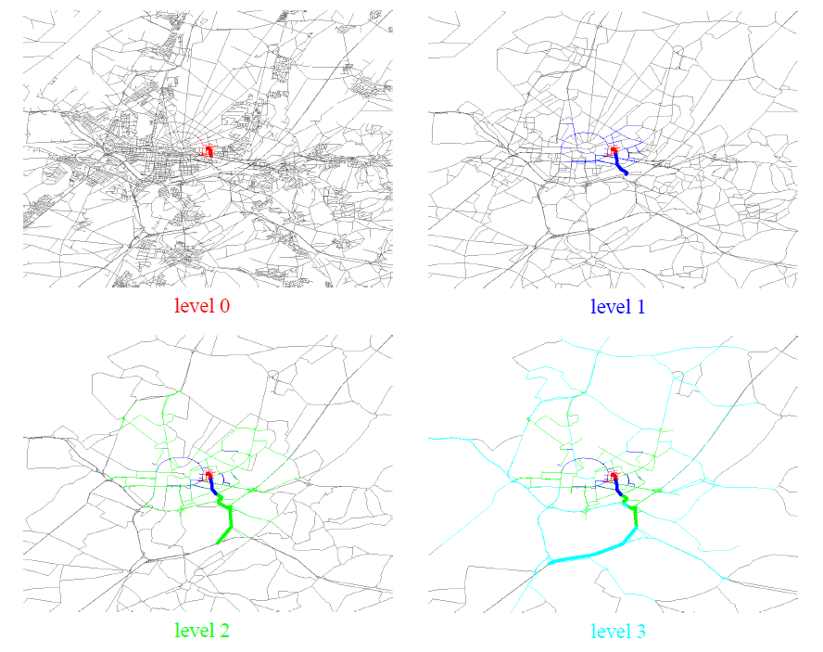
Prune and shrink

Slide 22

Reach
Gutman Ron: Reach-based Routing: A New Approach to Shortest Path Algorithms Optimized for Road Networks, 2004
Geo Architect in Telenav

Slide 23
Reach
Idea Reach(v) defines ball around v. If both s and t outside ball, v is not on shortest path

Slide 24
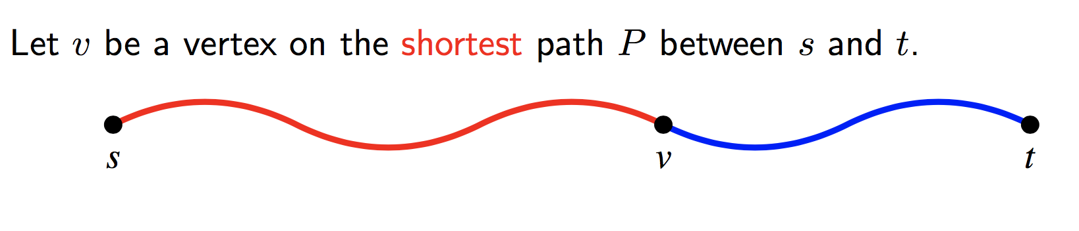
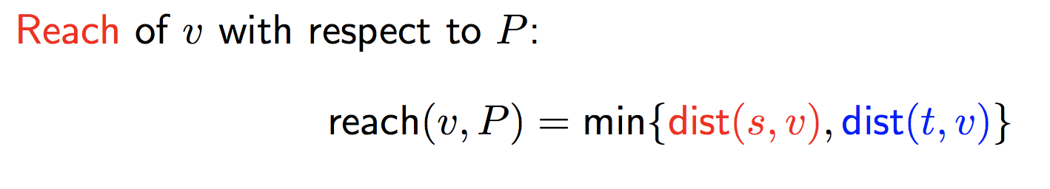
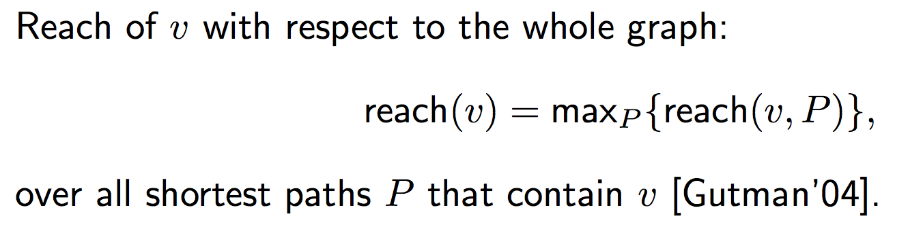
Reach
Notes:
Vertices on highways have high reach
Vertices on local roads have low reach

Slide 25
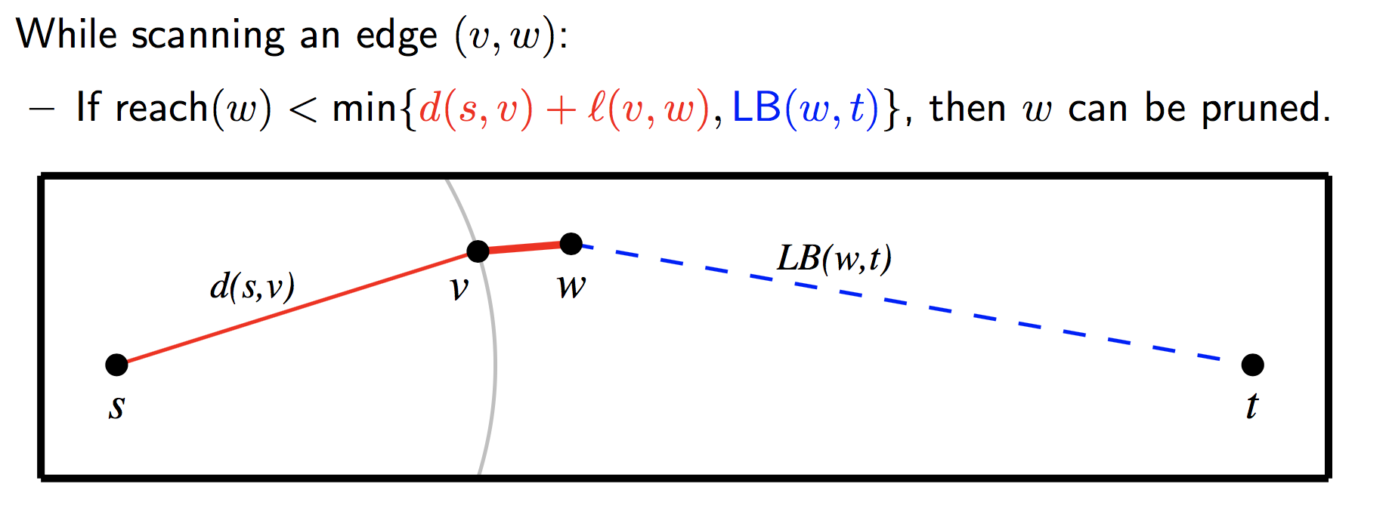
Reach for prune

Slide 26
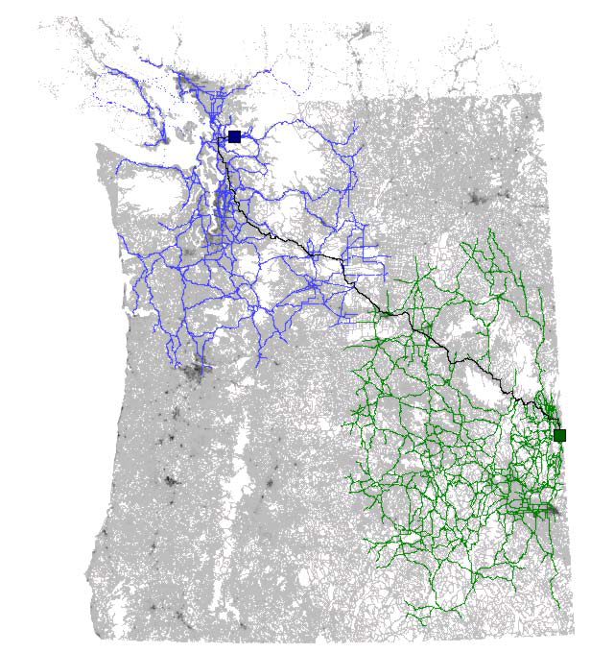
Reach(v)
http://www.cs.princeton.edu/courses/archive/spr06/cos423/Handouts/EPP%20shortest%20path%20algorithms.pdf
Notes:
Previous examples: Colors did not illustrate visited edges, but vertices visited were very close

Slide 27
Function Class – Attribute based promote
TME (Telenav, since 2006)
Micro (Telenav, since 2009)
NGX (Telenav, since 2014)
Notes:
5
These roads allow for high volume, maximum speed traffic movement between and through major metropolitan areas. There are very few, if any, speed changes. Access to the road is usually controlled.
4
These roads are used to channel traffic to Main Roads for travel between and through cities in the shortest amount of time. There are very few, if any, speed changes.
3
These roads interconnect FC 4 Roads and provide a high volume of traffic movement at a lower level of mobility than FC 4.
2
These roads provide for a high volume of traffic movement at moderate speeds between neighborhoods. These roads connect with higher Priority to collect and distribute traffic between neighborhoods.
1
These roads' volume and traffic movements are below the level of any other functional class

Slide 28
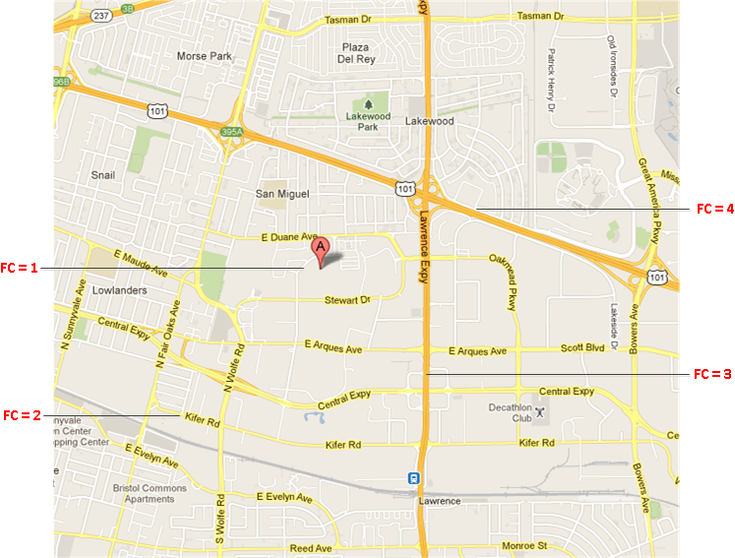
FC – illustration
Notes:
5
These roads allow for high volume, maximum speed traffic movement between and through major metropolitan areas. There are very few, if any, speed changes. Access to the road is usually controlled.
4
These roads are used to channel traffic to Main Roads for travel between and through cities in the shortest amount of time. There are very few, if any, speed changes.
3
These roads interconnect FC 4 Roads and provide a high volume of traffic movement at a lower level of mobility than FC 4.
2
These roads provide for a high volume of traffic movement at moderate speeds between neighborhoods. These roads connect with higher Priority to collect and distribute traffic between neighborhoods.
1
These roads' volume and traffic movements are below the level of any other functional class

Slide 29
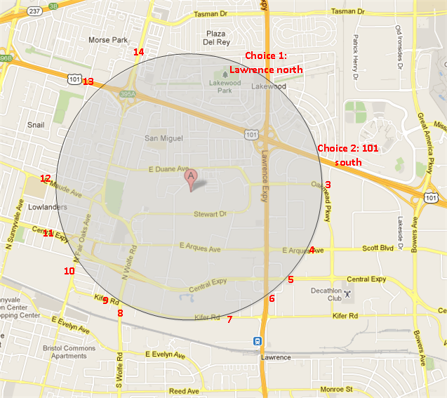
Level promote strategy - Count choices
FC keeps a count of node choices in the priority queue for each level, if the choices after level promotion reach a threshold (current is 40), then it is safe to promote
The choices threshold controls the acceleration of the routing exploration. As it becomes smaller, the exploration gets more accelerated, and the route calculation tends to become faster, but the probability of resulting in a less optimal route also becomes greater.

Slide 30
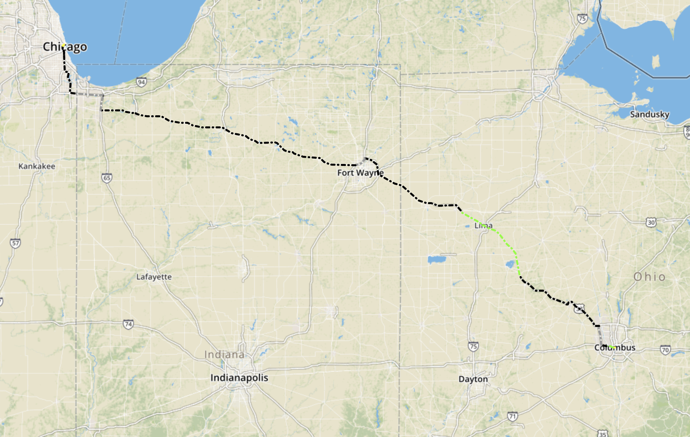
Columbus_to_Chicago avoid toll
Notes:
http://hqd-ssdpostgis-07.mypna.com/webtool/case_viewer.py

Slide 31
Shortcuts
A directed path u→v can be shortcut by a new edge (u,v)
Idea: Shortcuts reduce Reach(x) of vertices x along
the shortcut path (s→t distances are unchanged)
u
x
s
v
t
shortcut

Slide 32
Highway Hierarchies (HH)
MoRE Server(Telenav, since 2007)
LMoRE (Telenav, since 2008)
Google Maps, (Google, at the time of 2006)

Slide 33
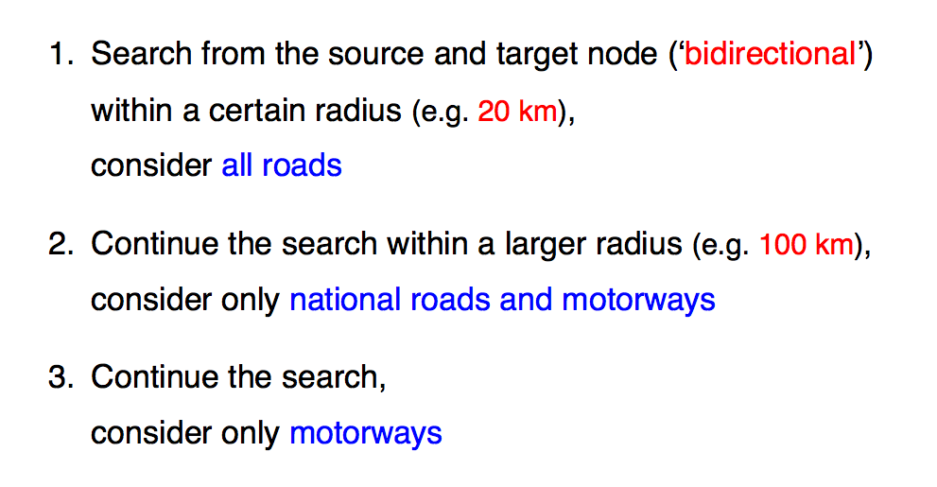
Highway Hierarchies

Slide 34
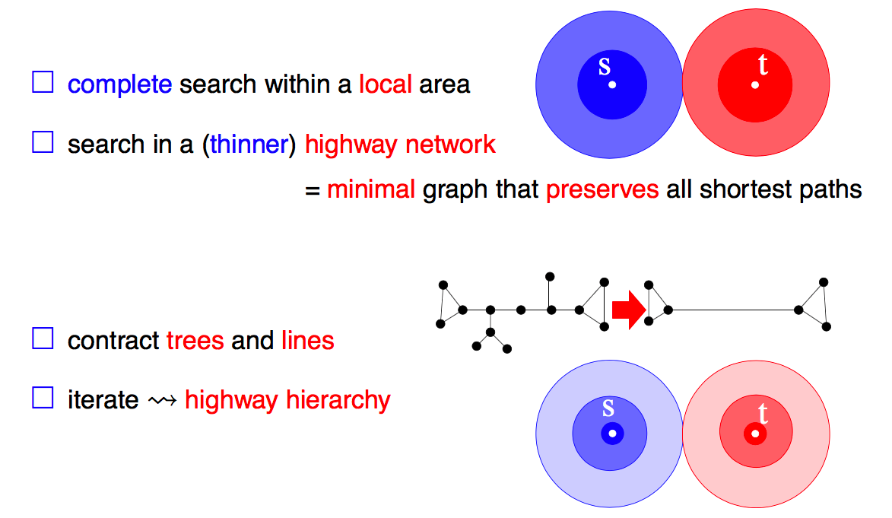
Extract Highway Hierarchies

Slide 35
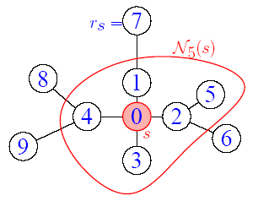
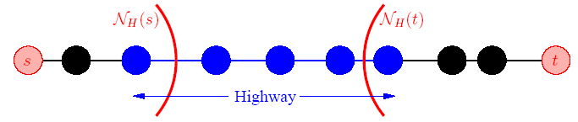
Local vs. Highway
Fig.3 Example of Highway
“Highway” is not the meaning in traditional way, which is just a concept versus “local”
Highway edge is organized in the higher level than local edge
Fig.2 Example of “Local” for node s
“Local” is defined by the Dijkstra rank of the node s with H (H=5)
Notes:
Passive
Abort

Slide 36
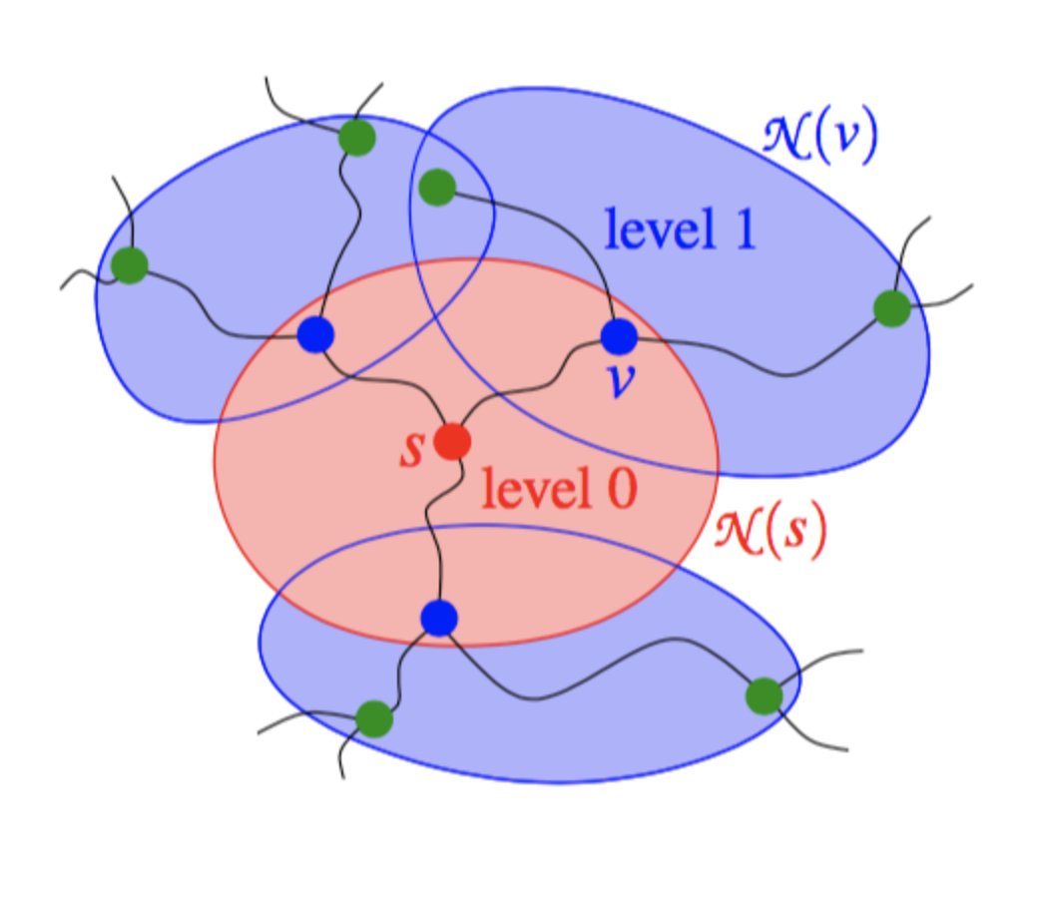
Query

Slide 37
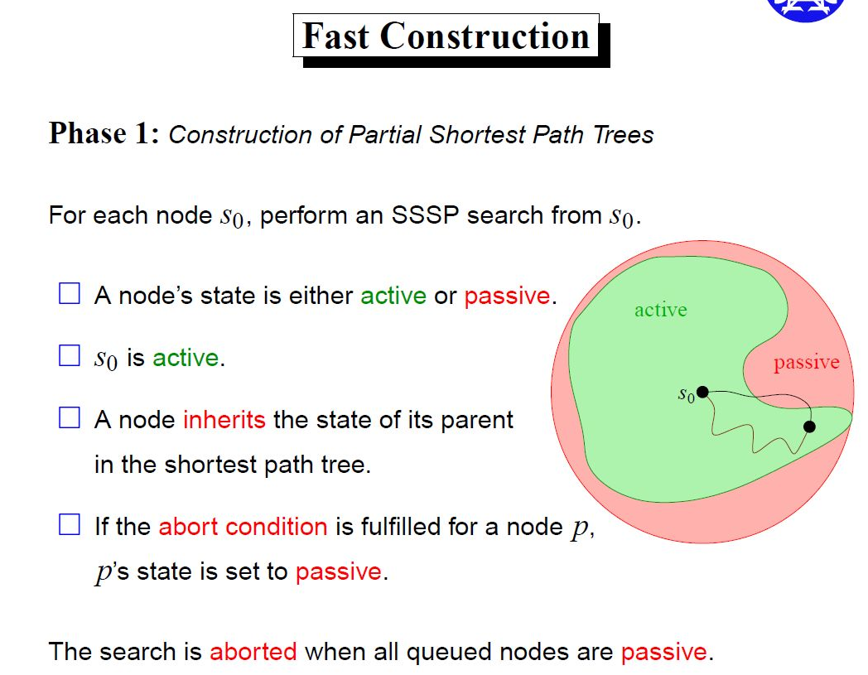
HH

Slide 38
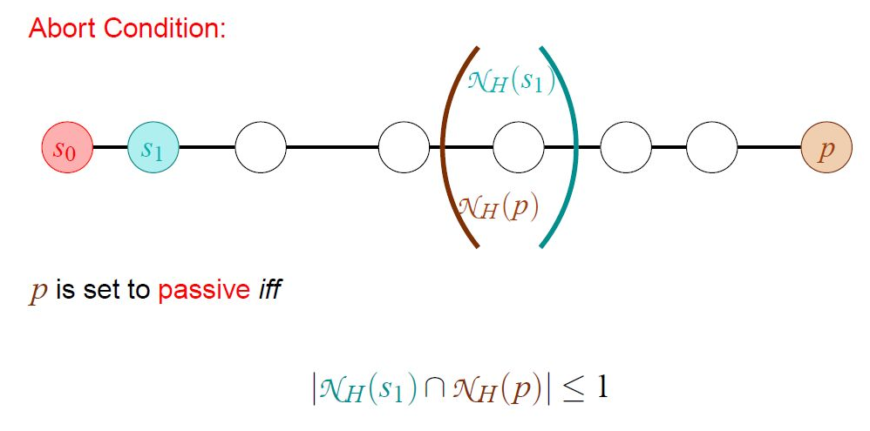
HH Fast construction

Slide 39
Contraction Hierarchies
GraphHopper
URL: https://github.com/graphhopper/graphhopper
Key word: Java, CH, <<Hidden Markov Map Matching Through Noise and Sparseness>>, OSM
OSRM
URL: https://github.com/Project-OSRM/osrm-backend
Key word: C++, CH, OSM

Slide 40
What is Contraction Hierarchies (CH)?
1-line explain
Highway Hierarchy
Explorer the hierarchical structure of road network by selecting highway
Contraction Hierarchy
Explorer the hierarchical structure of road network by node contraction
Order nodes v₁,...,v_{n} in increasing order of importance
Repeatedly contract unimportant nodes by adding shortcuts required by shortest paths

Slide 41
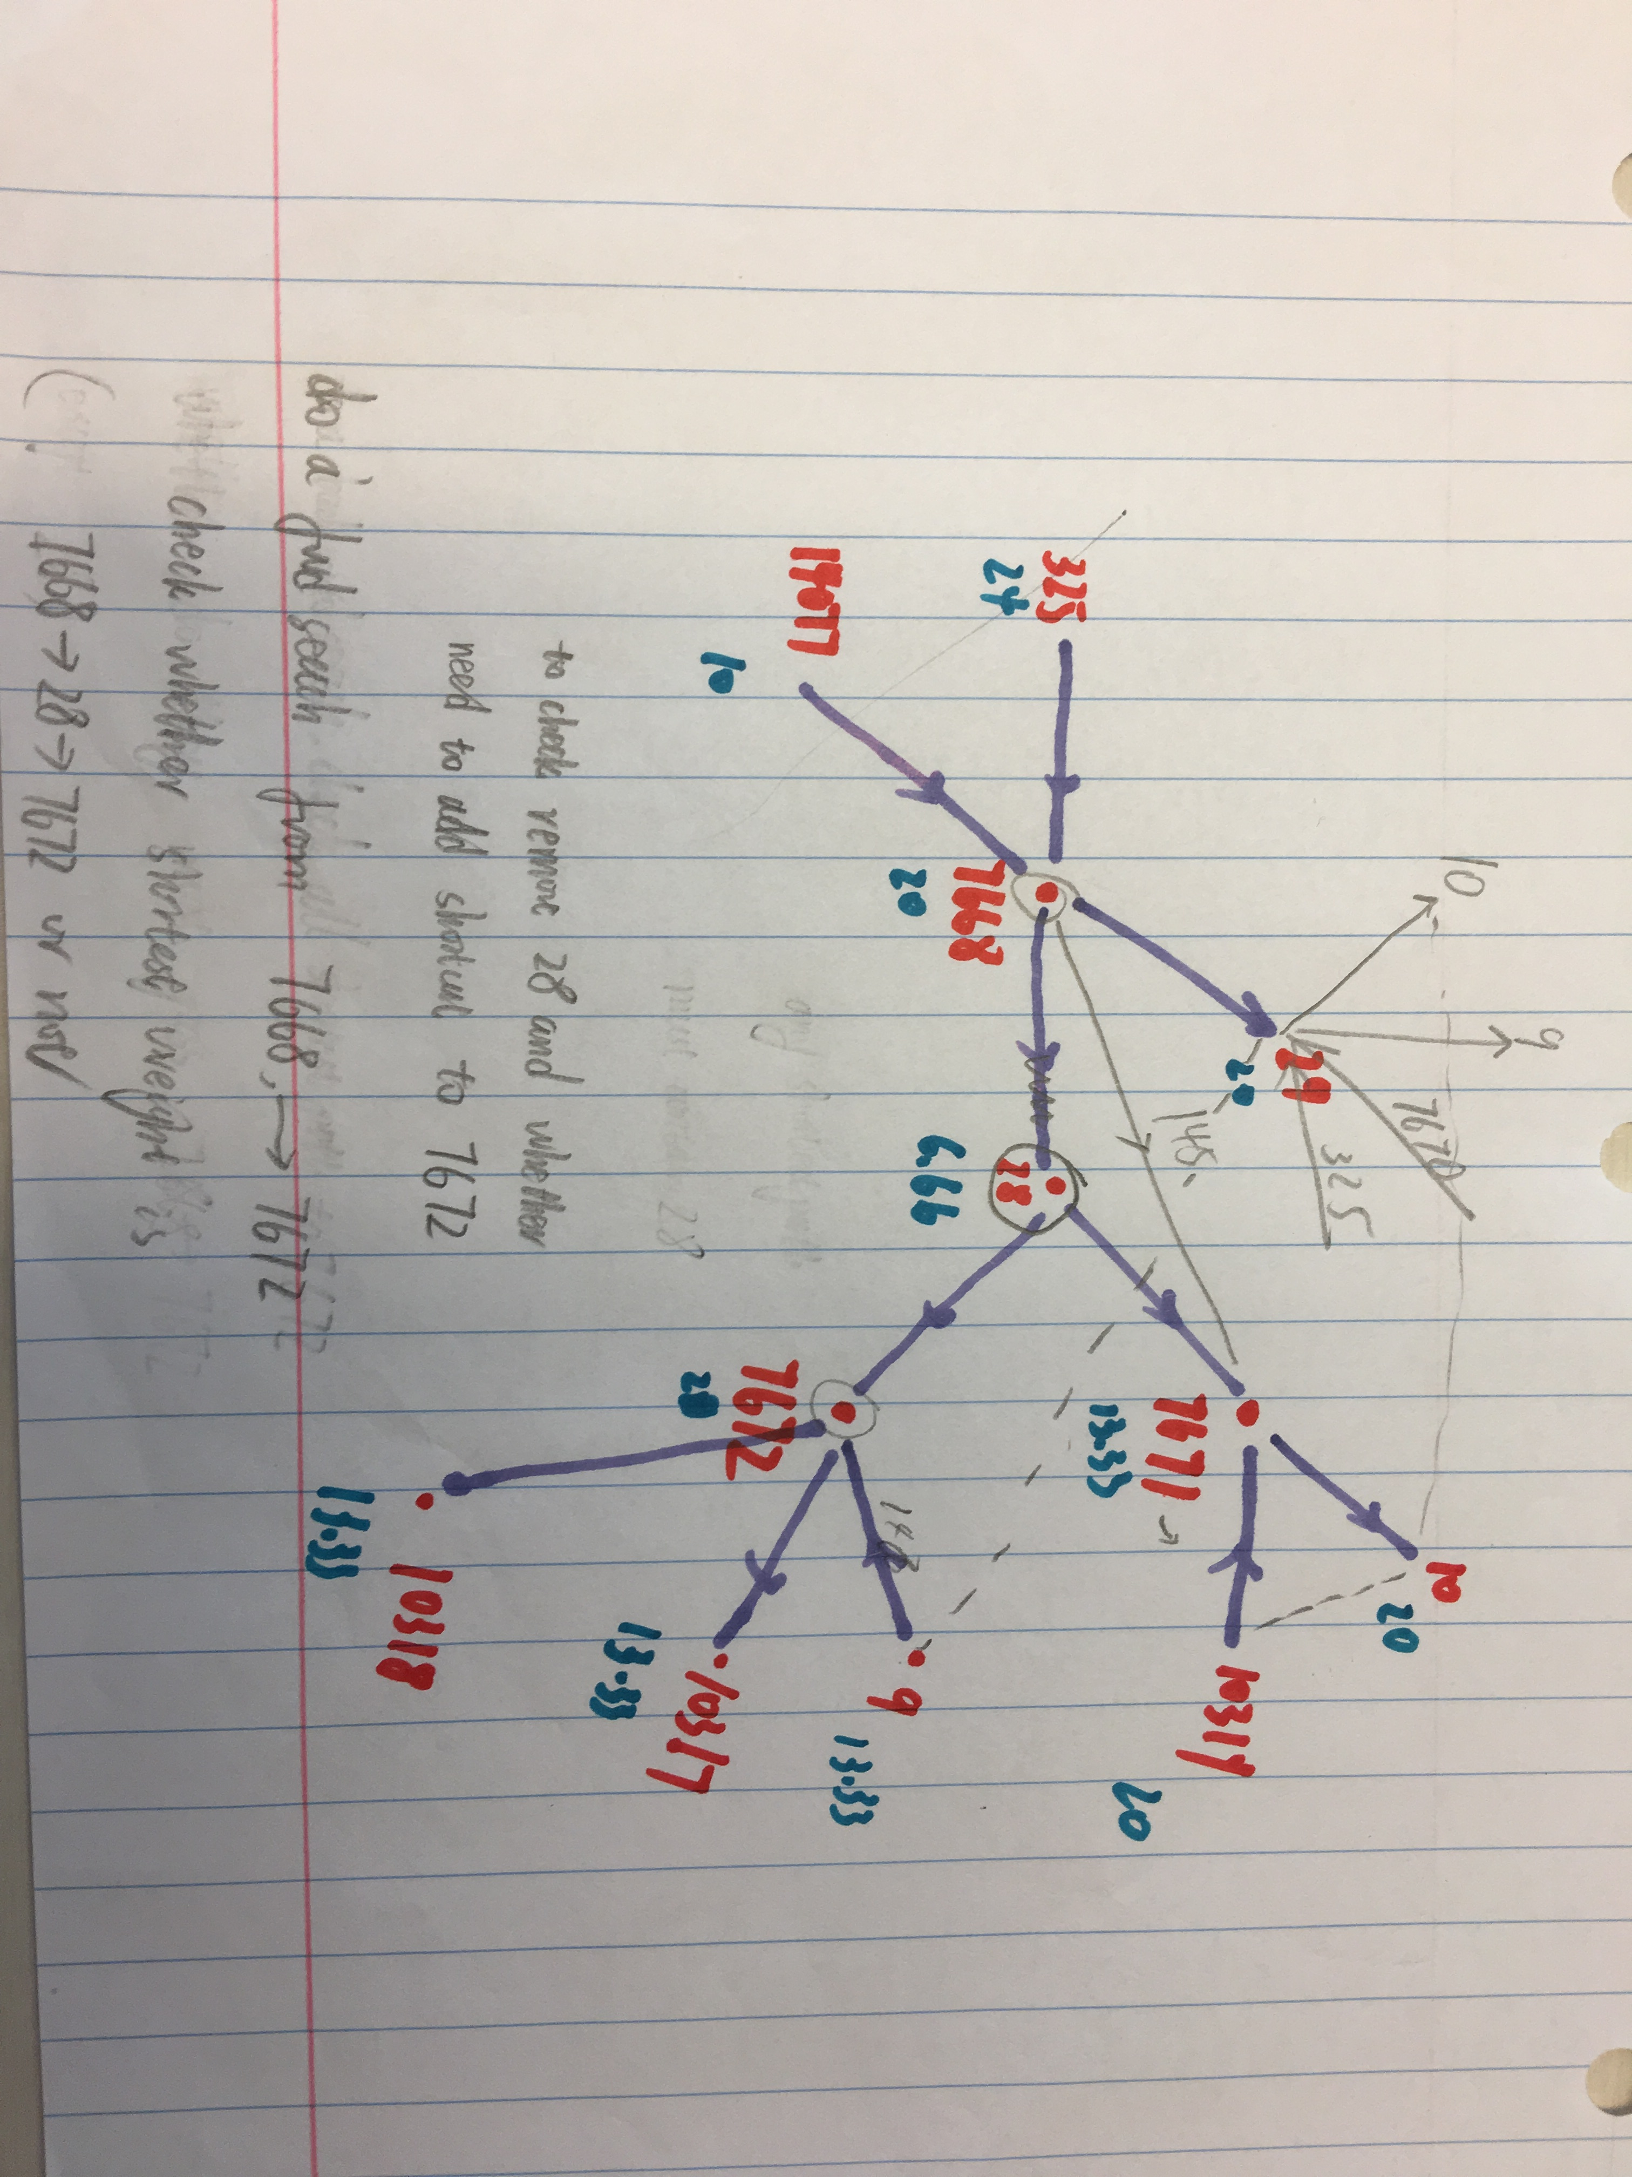
Hand contract

Slide 42
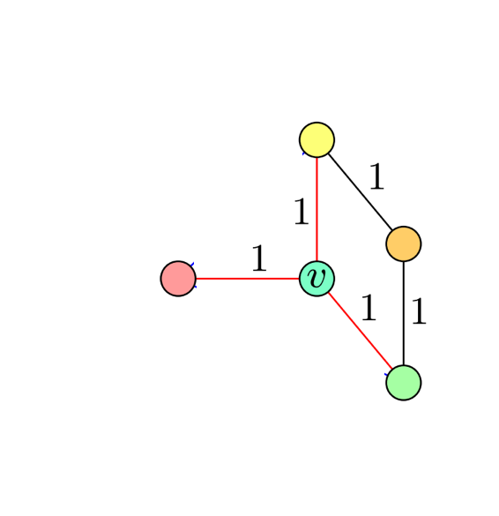
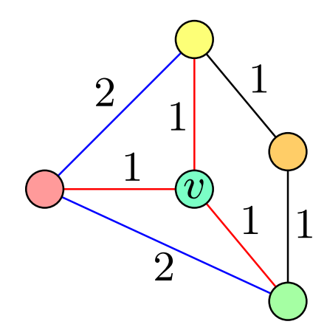
CH basic
Notes:
Passive
Abort

Slide 43
Contraction Hierarchies (A example for compiling)
2
3
2
1
2
2
6
1
4
3
5
Step 1: Use the node-ID as node ordering.
Step 2: Contract node, add necessary shortcut(s).
Repeat the above 2 steps in the below remaining graph.
2
5
1
2
2
6
4
3
5
3
2
1
December 11, 2018
Notes:
Let's have a look on the simplest graph.
White circle is node. Number inside is nodeID.
Arrow represent edges. And the square and number inside represent the cost of the edge. Maybe time or distance.
First we will choose the node-ID as the contract order. We use the height represent the node's order.
When we contract node1, edge <6,1,4> is the shortest path between node 6 and node 4, so we add a necessary shortcuts.
And then node1 and the adjacent edges are invisible for the following preprocess.
This is remaining graph

Slide 44
Contraction Hierarchies (A example for compiling, cont’d)
5
1
2
2
6
4
3
5
2
3
2
1
December 11, 2018
Notes:
Node2 has no inEdge.
So contract node2 will not introduce shortcut.

Slide 45
Contraction Hierarchies (A example for compiling, cont’d)
5
3
6
4
5
2
3
2
1
2
3
2
1
December 11, 2018

Slide 46
Contraction Hierarchies (A example, compiling result)
2
3
2
1
2
2
6
1
4
3
5
6
8
5
5
2
4
3
2
3
2
1
3
2
1
No witness path found
December 11, 2018

Slide 47
Static Contraction Hierarchies – Online Route Computing
Bi-Directional Dijkstra search from source and target 1 by 1
During both searches, nodes can only 'see' the edges lead to higher or equal level nodes.(query relaxes only edges to more “important” nodes)
meet point
6
8
5
5
2
4
3
2
3
2
1
3
2
t
backward search
s
1
forward search
December 11, 2018
Notes:
Bi-Directional upwards-only Dijkstra search from source and target both, until 2 search trees meets, and the tentative path weight is not less than the top nodes' weight in both 2 search trees.

Slide 48
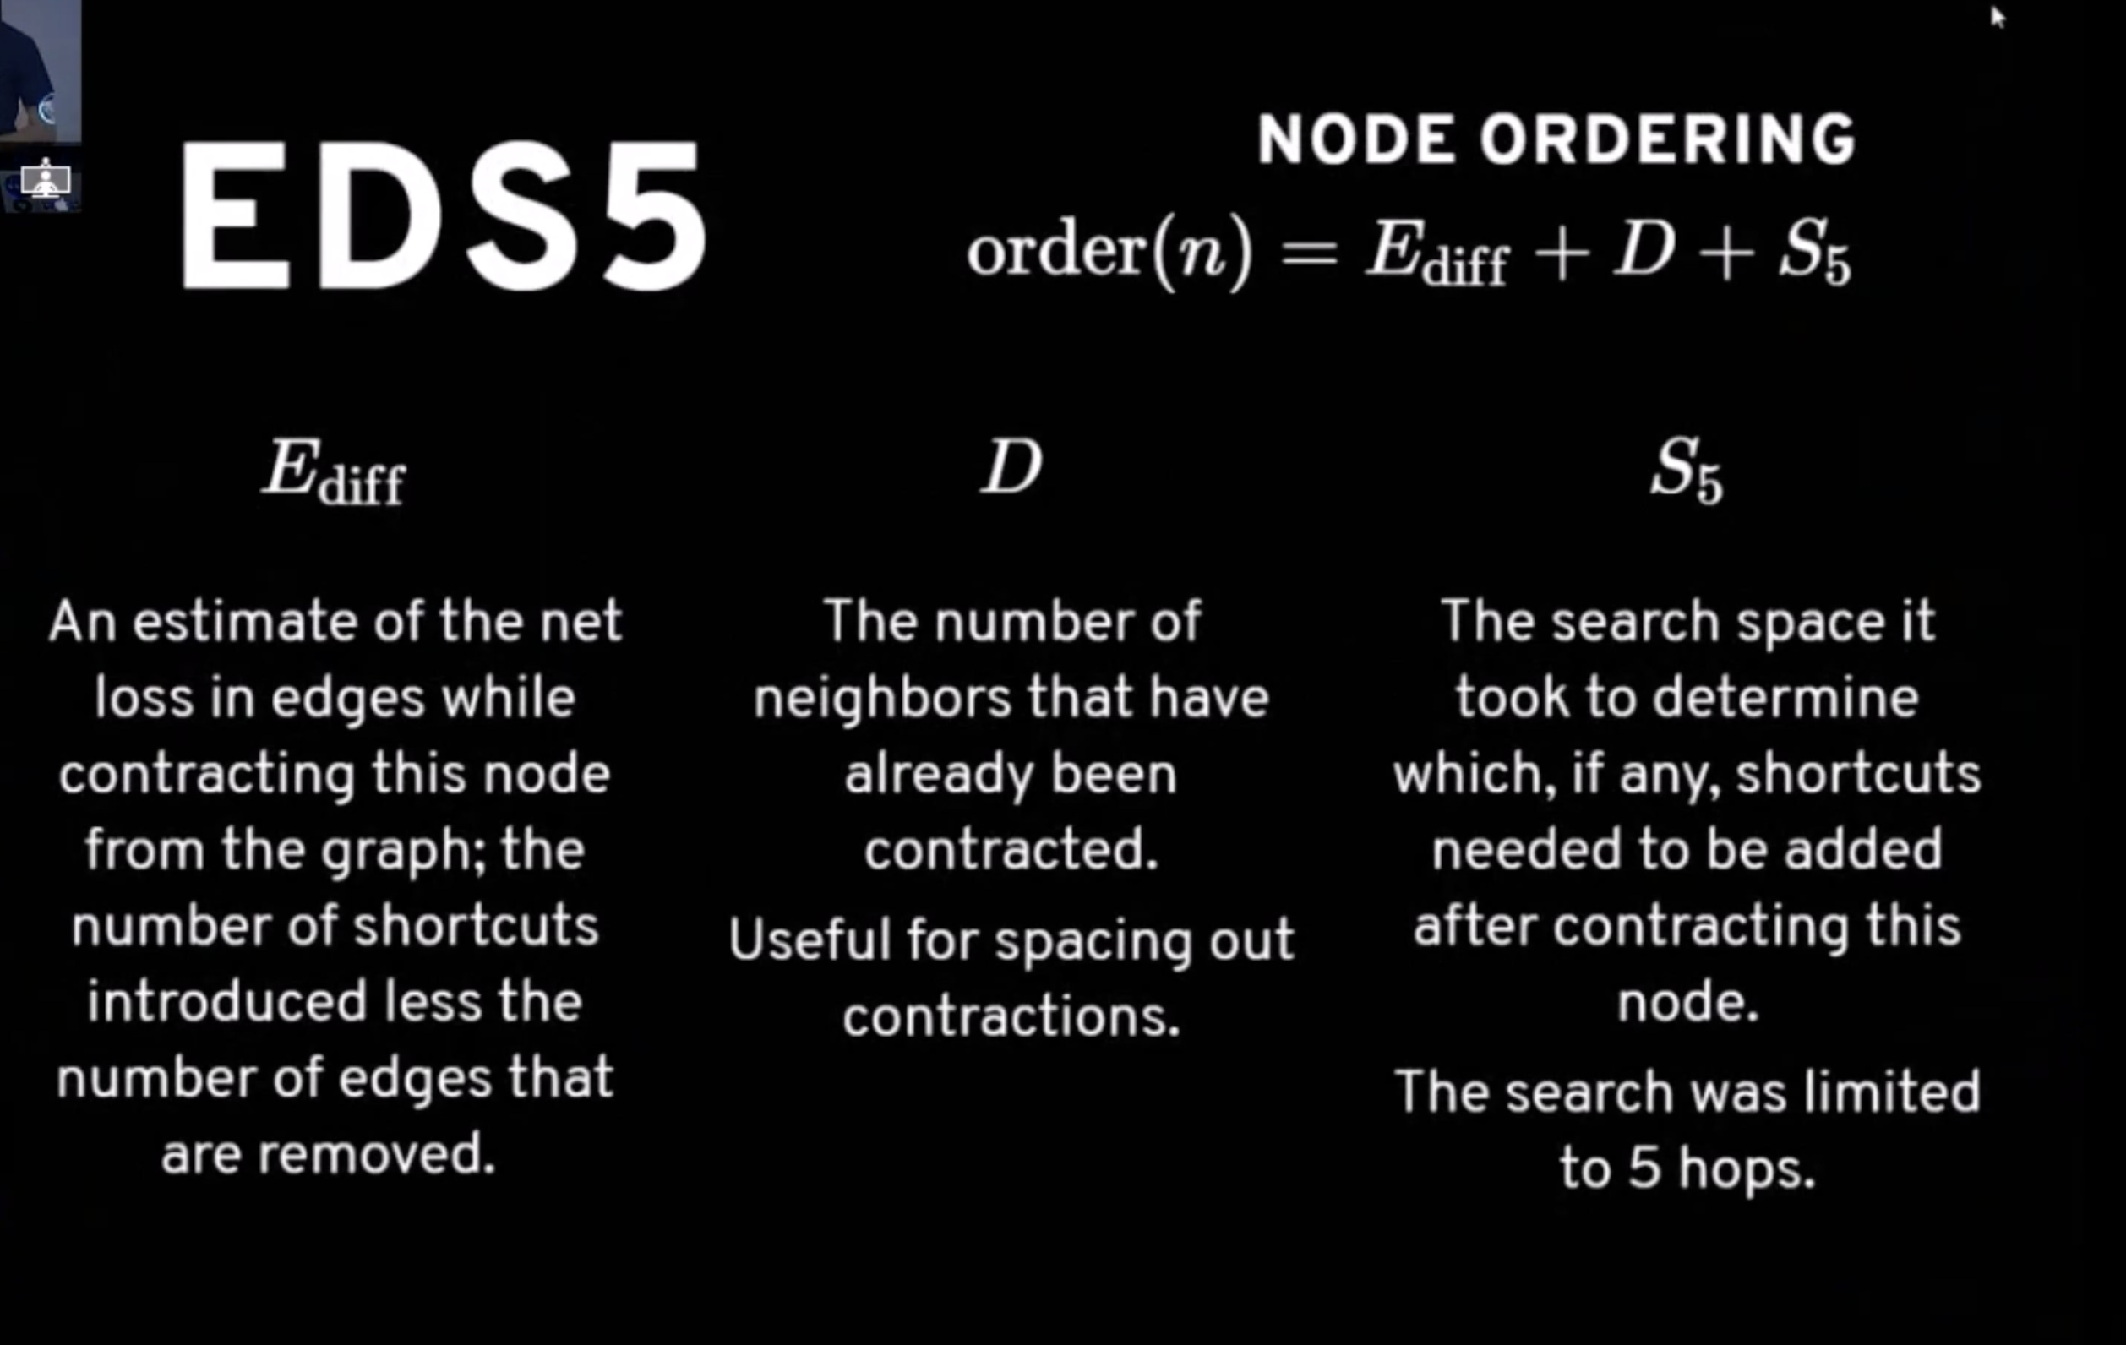
Node Ordering

Slide 49
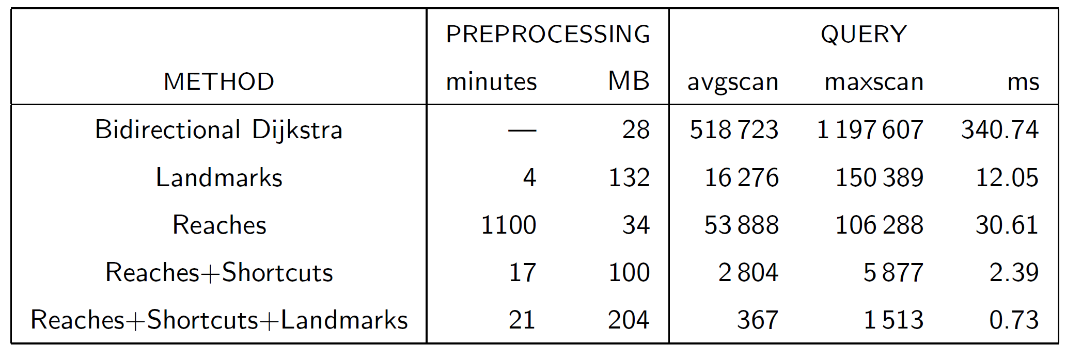
Experiments – Northwest US
http://www.cs.princeton.edu/courses/archive/spr06/cos423/Handouts/EPP%20shortest%20path%20algorithms.pdf

Slide 50
Agenda
Problem Set
Basic Algorithm
Goal directed technical
Hierarchical technical
Bounded hop technical
Q&A

Slide 51
Transit-Node Routing
For a real road network, there exists a relatively small set of nodes, such that any shortest path of sufficient length will pass at least one of them
For the Netherlands, every shortest path of at least 100 km will use a highway, so we can take all highway exits

Slide 52
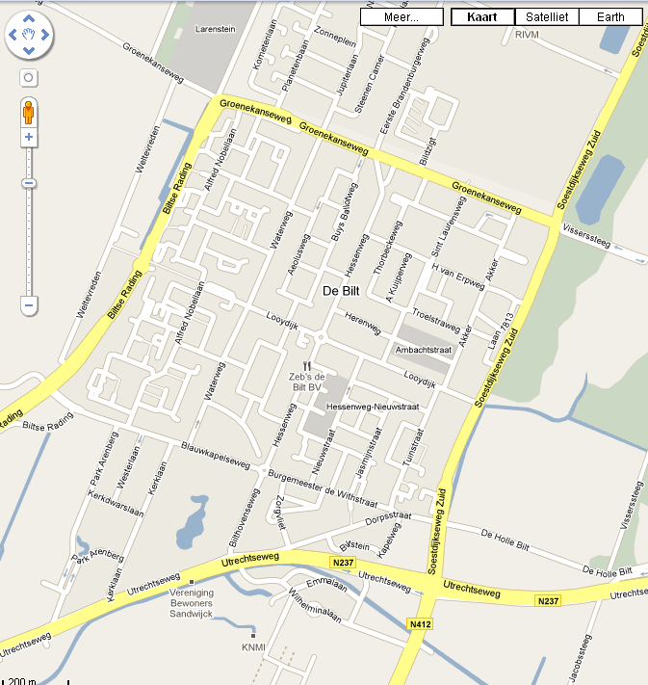

Slide 53
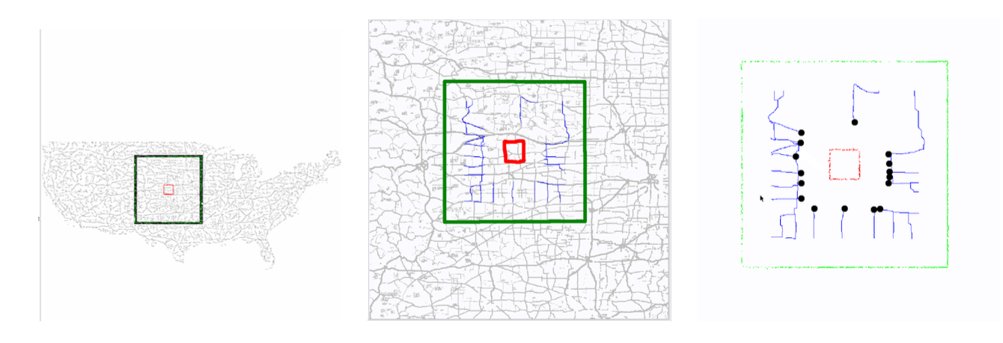
Transit neighborhood
Notes:
Imagine you live in a big city and intend to travel long-distance by car
There will be few roads via which you will actually leave the urban area when travelling on a shortest path

Slide 54
Choosing transit nodes
Use grid-based partition and use intersections of the network and the grid

Slide 55
Choosing transit nodes
Use grid-based partition and use intersections of the network and the grid
Select nodes from V_{inner} based on whether they lie on some shortest path from a node in C to V_{outer}
outer
inner
C
Notes:
5 * 5 inner
9 * 9 outer

Slide 56
Choosing transit nodes
Consider every center square C
Use 5 x 5 squares to define V_{inner}
Use 9 x 9 squares to define V_{outer}
Consider all paths from some node in C to some node in V_{outer}
All nodes of V_{inner} on such a path will go in the set of transit nodes (eventually united over all C)
Run Dijkstra from every node in C until all nodes in V_{outer} are settled

Slide 57
Choosing transit nodes
Given s and t, if they are more than 4 grid cells apart (horizontally or vertically), their shortest path must contain a transit node
This provides an easy test for locality of any query (later, during query time)

Slide 58
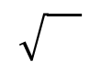
Transit Node Routing
recurse
u
v
Idea All shortest paths s→t, where s and t are far away, must cross few possible transit nodes
Identify few transit nodes in graph ~ n
Compute All-Pair-Shortest-Path matrix for transit nodes
For each vertex s find very few transit node distances (US ~10)
Query(s,t) far away queries For all (u,v), transit nodes u and v for s and t respectively, find d(s,t)=d(s,u)+d(u,v)+d(v,t) using table lookup
Practice: Combine recursively with Highway Hierarchies
s
t

Slide 59
Hub Labelling
For all nodes v store two lists L_{f}(v) and L_{b}(v), such that for all (s,t) pairs, the shortest path s→t contains a node u, where u∈L_{f}(s)∩L_{b}(t)
Trivially exist; hard part is to limit space usage
u
s
t
L_{f}(s)
u | d(s,u)
L_{b}(t)
u | d(u,t)
small
small

Slide 60
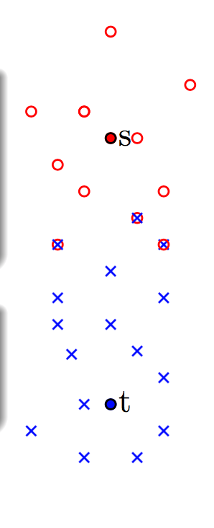
Hub selection

Slide 61
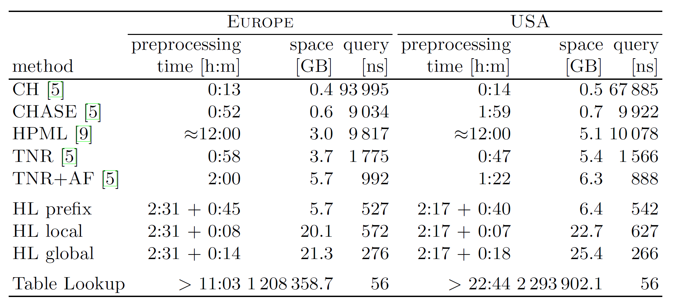
Hub Labelling comparison
Contraction hierarchies
Arc flags
Transit node
Hub labelling
Ittai Abraham, Daniel Delling, Andrew V. Goldberg, Renato Fonseca F. Werneck. A Hub-Based Labeling Algorithm for Shortest Paths in Road Networks. Symposium on Experimental Algorithms (SEA), Lecture Notes in Computer Science, Volume 6630, 2011, pp 230-241.
Notes:
Table from page 239
Conclusion: Best query time for Hub labelling approach ~ time for 5 memory access (cache lines); space still reasonable
HL = Hub Labelling (prefix = space optimized; global/local = optimized for global/local queries)
CH = Contraction Hierarchies
CHASE = Contraction Hierarchies + Arc flags
HPML = High Performance Multi Level Routing
TNR = Transit Node Routing (TNR+AF = Transit Node Routing + ArcFlags + Contraction Hierarchies)

Slide 62
The end, thanks

Slide 63
FC roads distribution
FC value | Edge Count | Percent
1 | 26,393,008 | 92.26%
2 | 1,549,488 | 5.42%
3 | 437,110 | 1.53%
4 | 181,505 | 0.63%
5 | 45,776 | 0.16%
Total Edge Count | 28,606,887
NT NA 2006 statistics data

Slide 64
Notes:
Questions for Perry:
Bi-A*, consistent
Compute Reach ??? upper bounds, partial shortest path tree, penalties
HH : Node Reduction/ Edge reduction
CH, dynamic

